Slide 1
Production Planning and Management

Slide 2
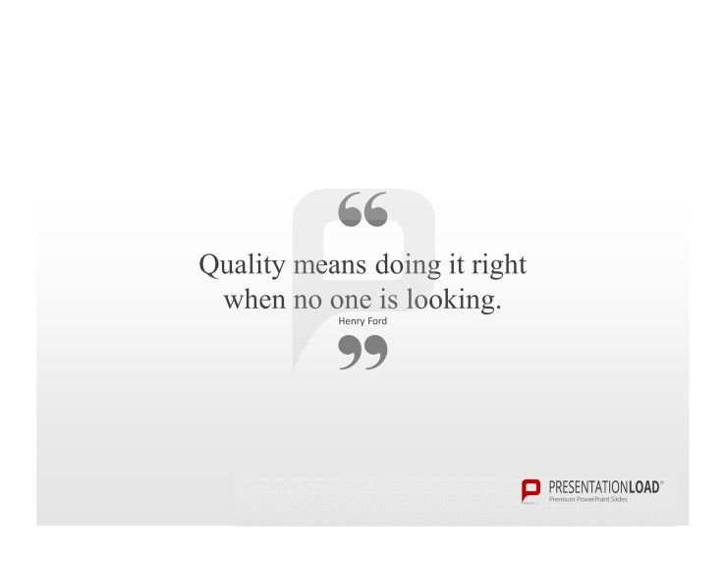
Total Quality Management (TQM)

Slide 3
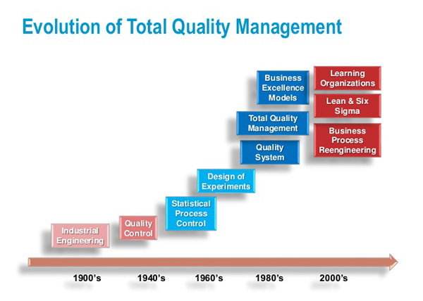
Notes:
https://www.youtube.com/watch?v=42UgAS-U1-o

Slide 4
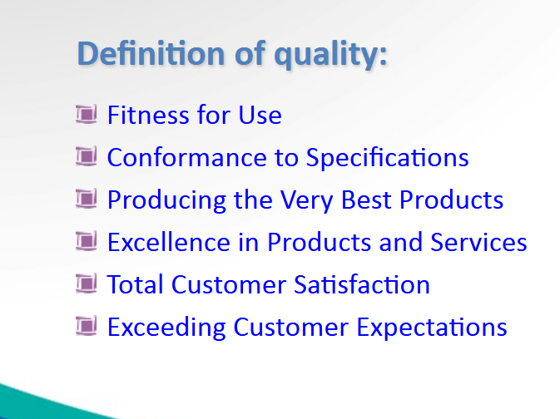
`

Slide 5
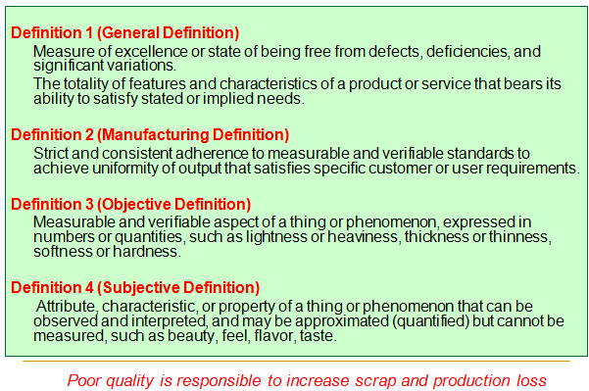

Slide 6
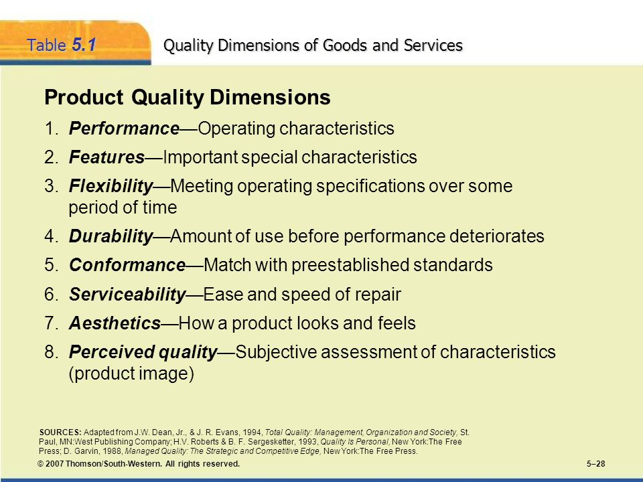

Slide 7
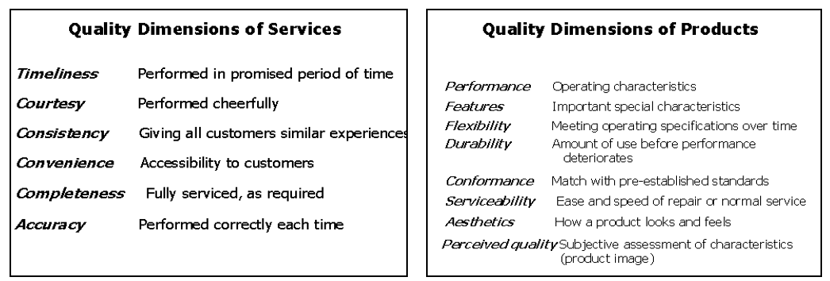
Service Quality Dimensions

Slide 8
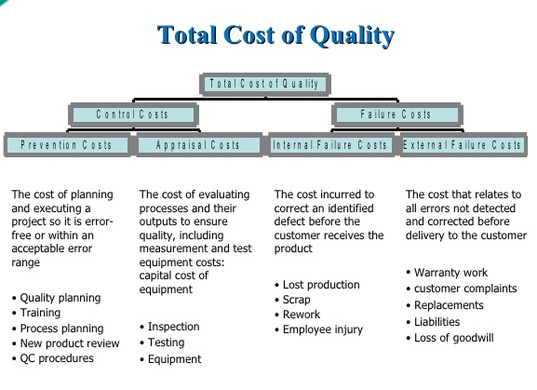

Slide 9
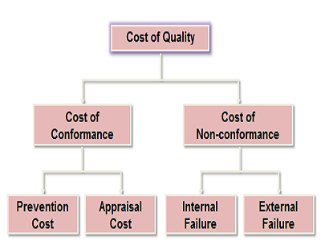

Slide 10
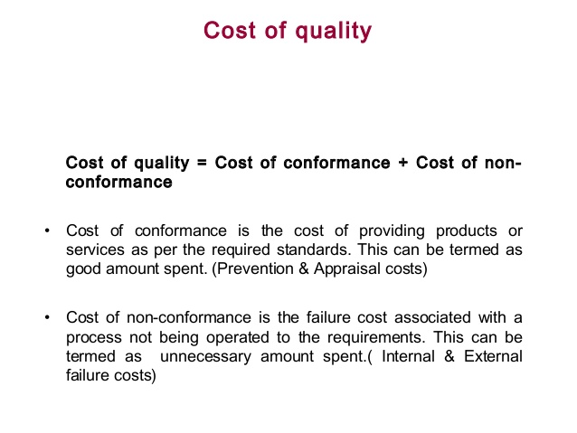

Slide 11
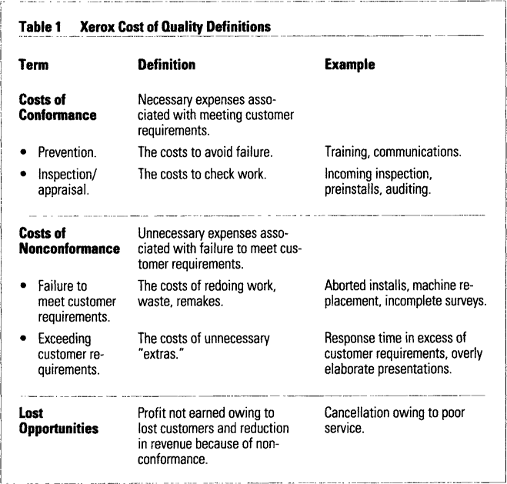

Slide 12
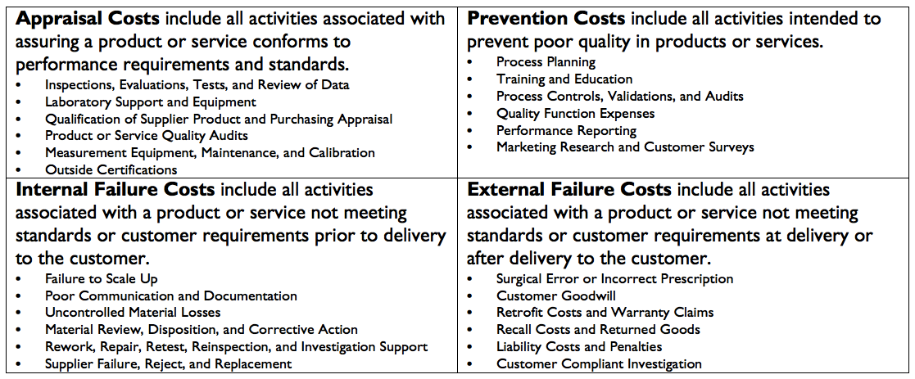

Slide 14
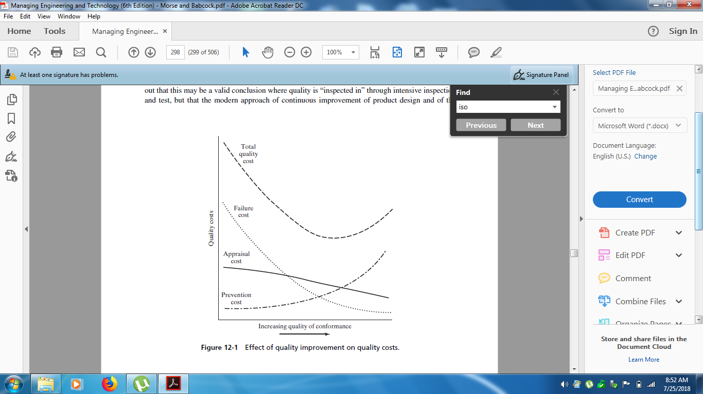

Slide 15
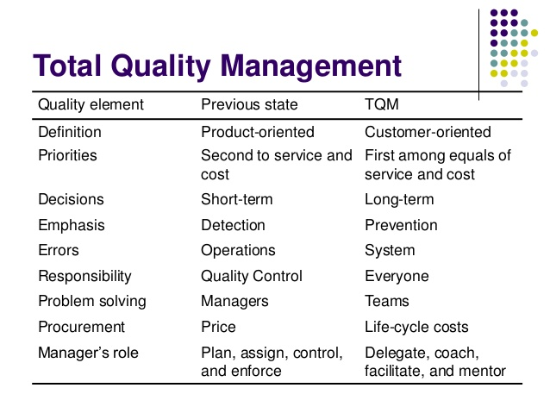

Slide 16
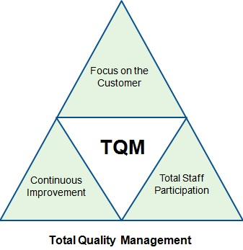

Slide 17
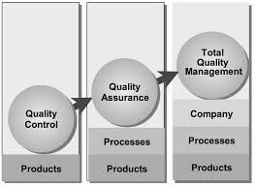

Slide 18
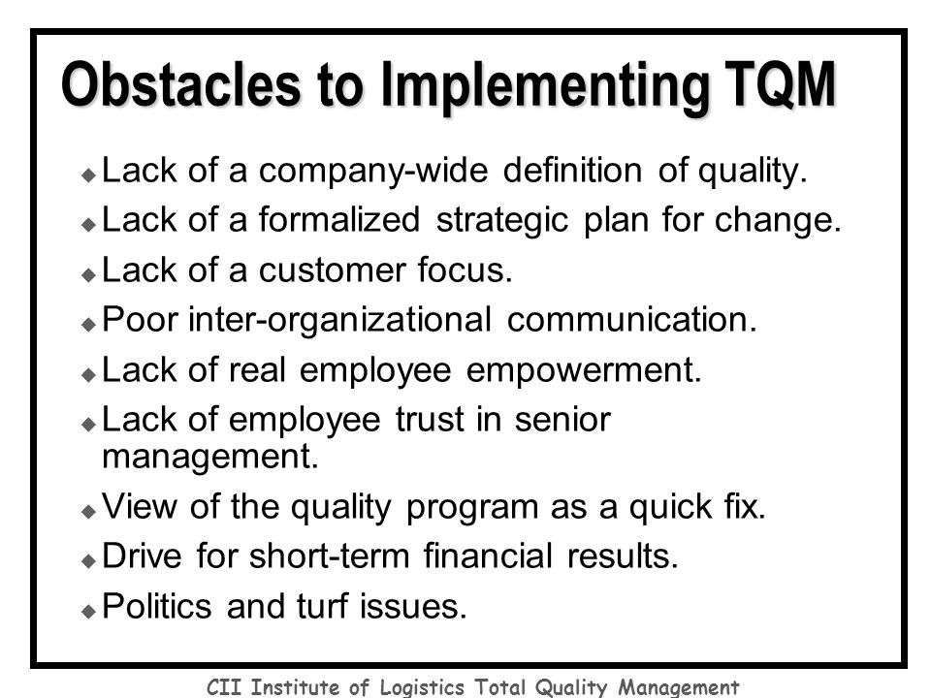

Slide 19
International Organization of Standardization (ISO)
ISO 9000 is a family of quality improvement standards released by ISO.
The 9000 series helps an organization define steps to create and maintain a quality management system.
Thoughtful work toward ISO 9001 certification (the most well-known standard issued by ISO) can increase efficiency and customer satisfaction for service and transactional businesses, as well as for manufacturing and real-goods organizations.
Although ISO standards provide a foundation for thinking about and working toward quality, however, certification does not guarantee immediate business growth and cost savings.

Slide 20
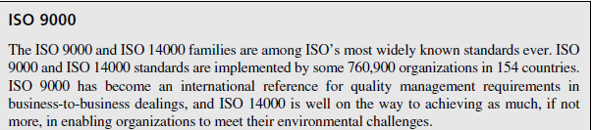
ISO 9000 vs. ISO 9001
ISO 9000 is a family of standards encompassing a handful of documents. ISO 9000 is also the name of the document that details the fundamentals and vocabulary of what constitutes a quality system.
ISO 9001 represents specific requirements to improve processes, and is considered the most essential certification of the ISO 9000 family.

Slide 21
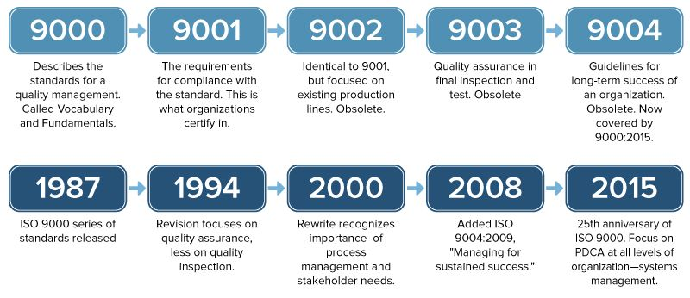

Slide 22
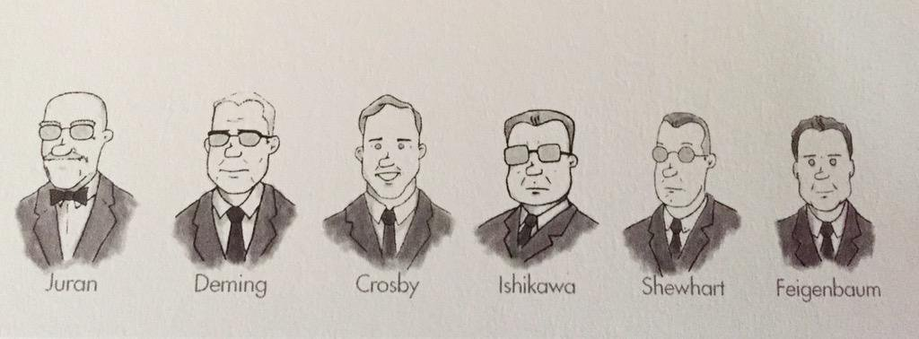
Quality Gurus

Slide 23
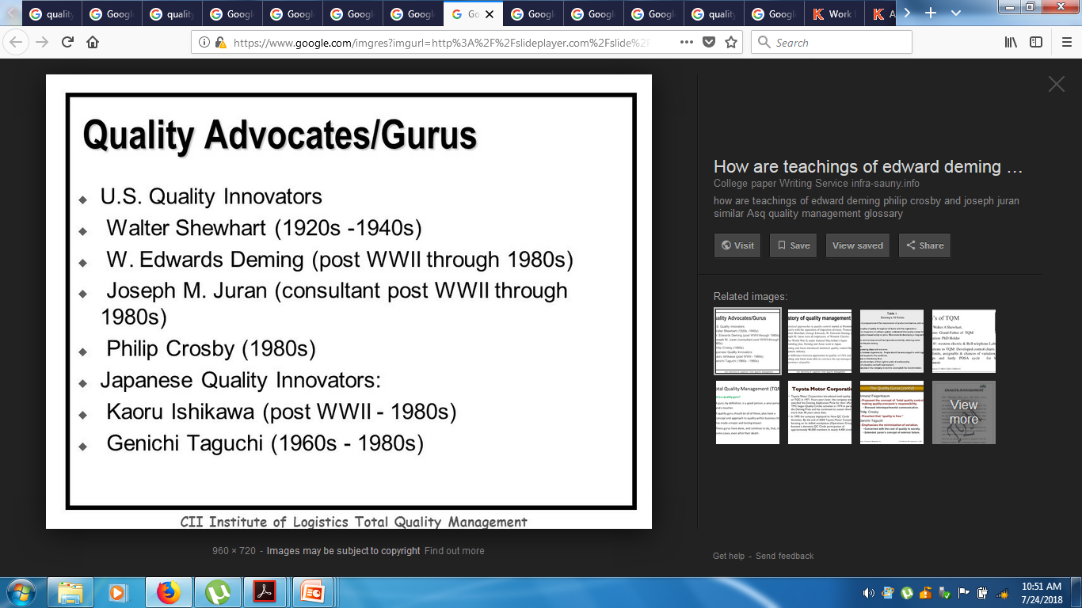

Slide 24
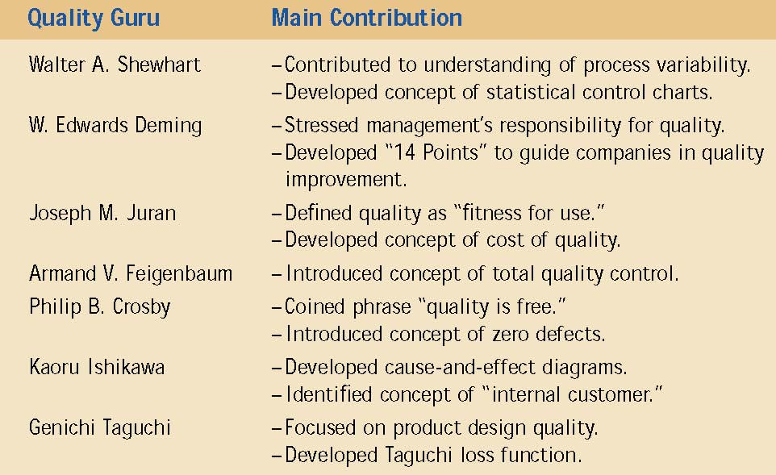

Slide 25
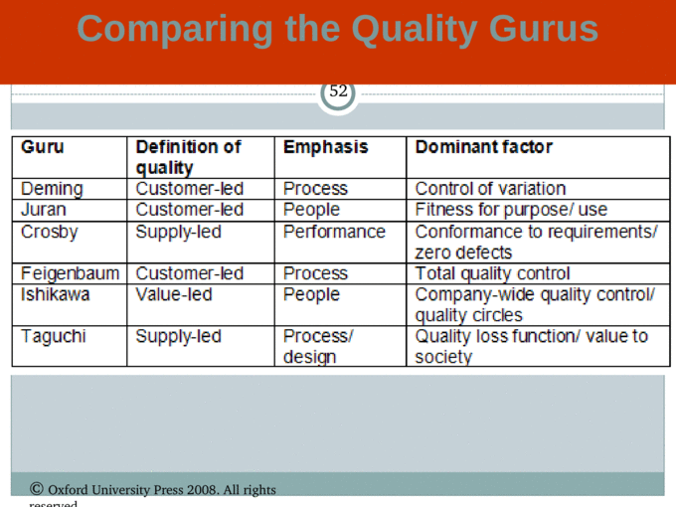

Slide 26
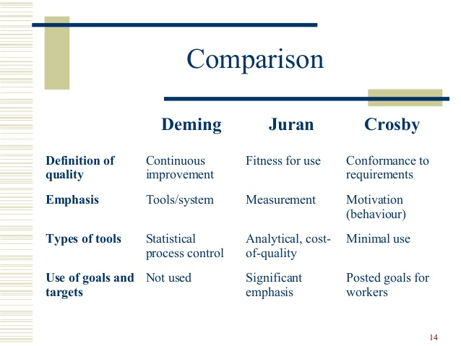

Slide 27
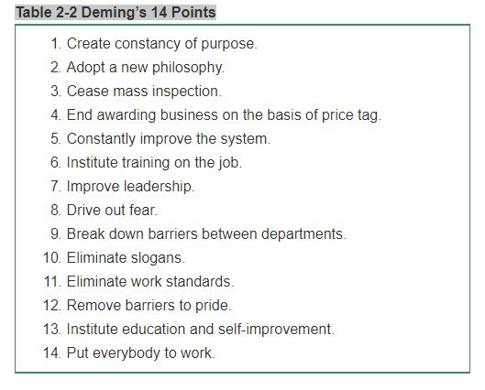

Slide 28
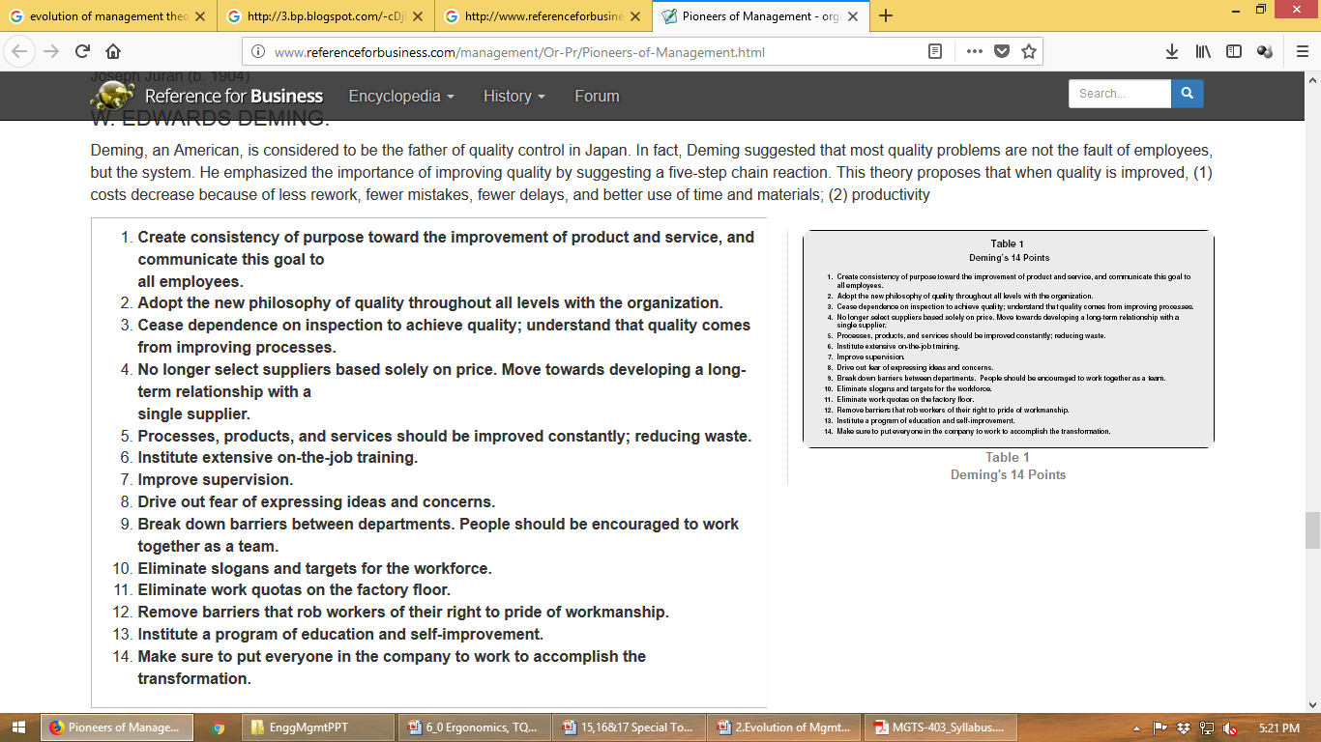
Deming’s 14 Points

Slide 29
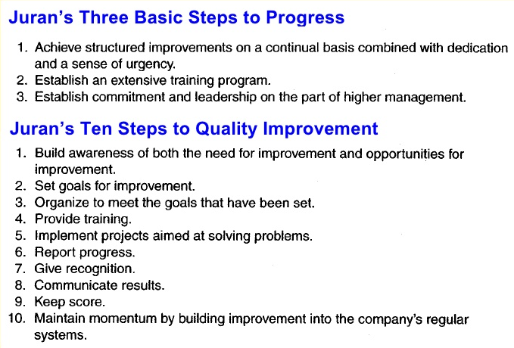

Slide 30
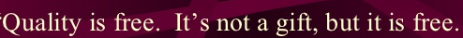
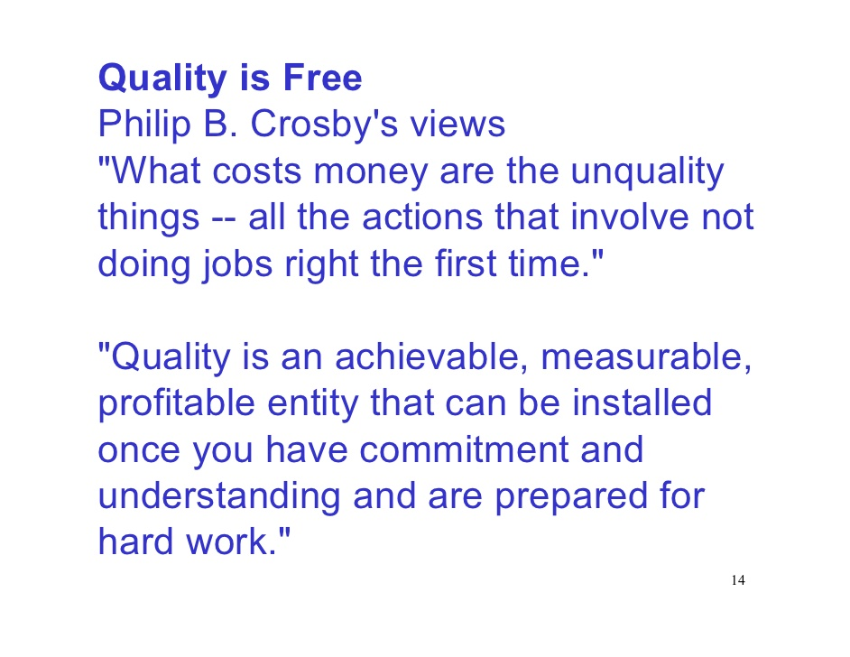
Philip B. Crosby

Slide 32
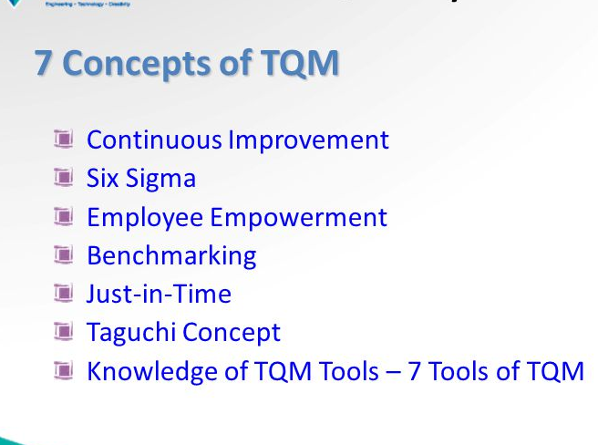

Slide 33
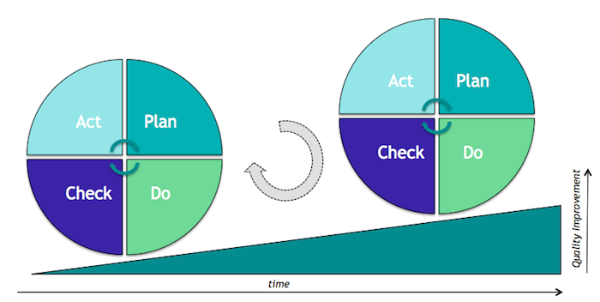
Continuous Improvement
The PDCA Cycle is a framework for problem solving, continuous improvement and change. It is widely recognized as the basis of continually improving
the quality
of processes,
products,
and services.

Slide 34
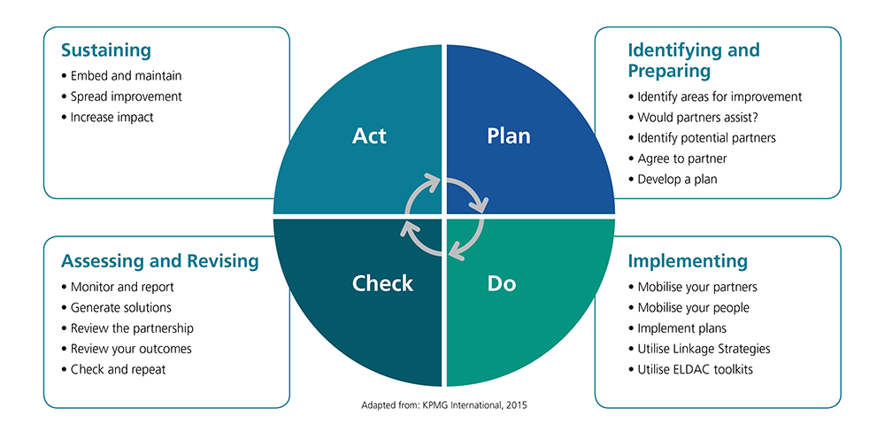

Slide 35
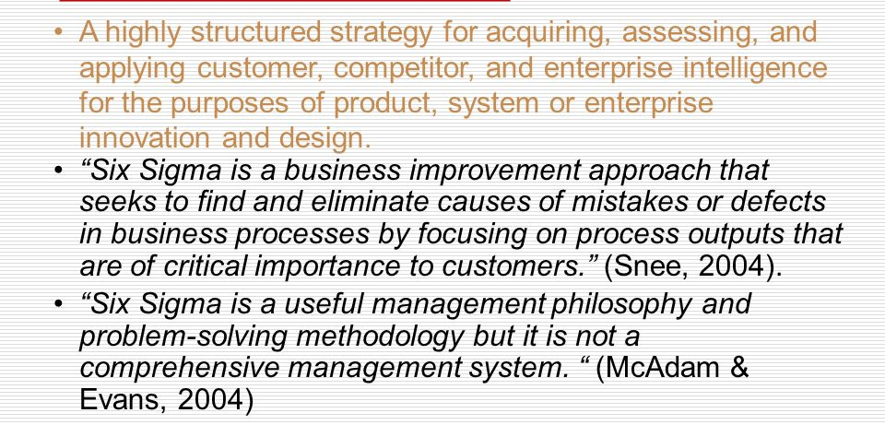
Six Sigma
Notes:
https://www.youtube.com/watch?v=4EDYfSl-fmc

Slide 36
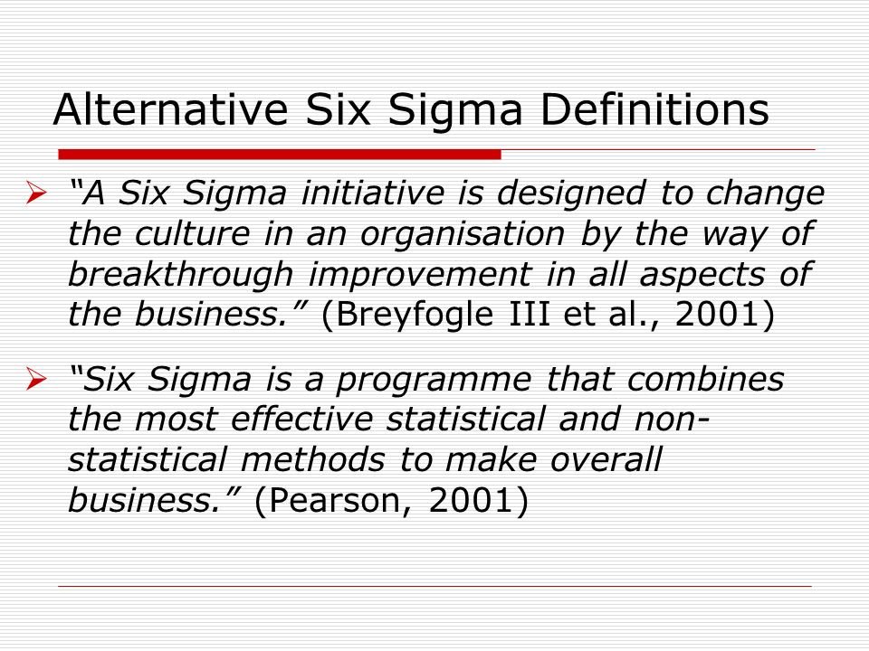
Alternative Definitions

Slide 37
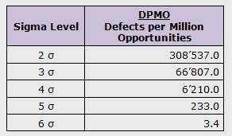
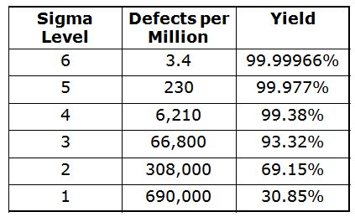

Slide 38
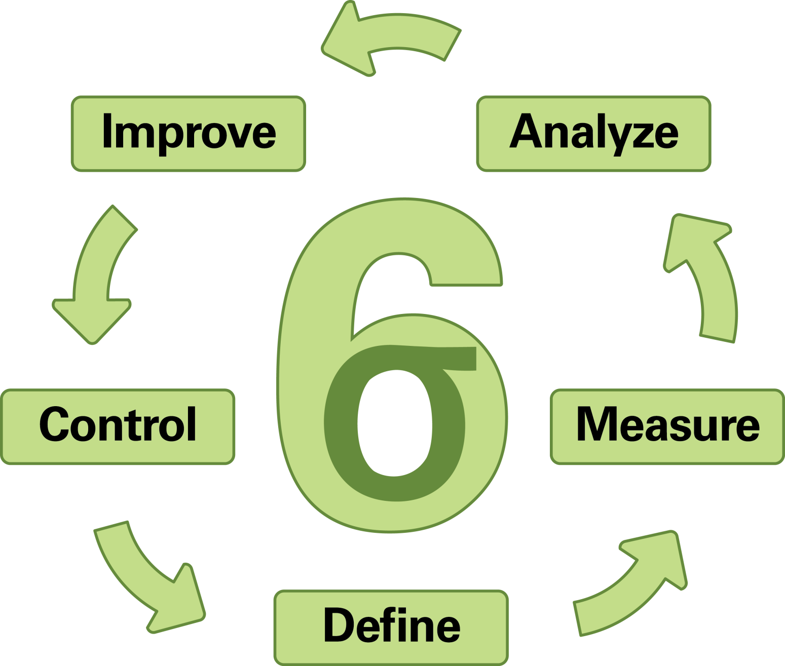

Slide 39
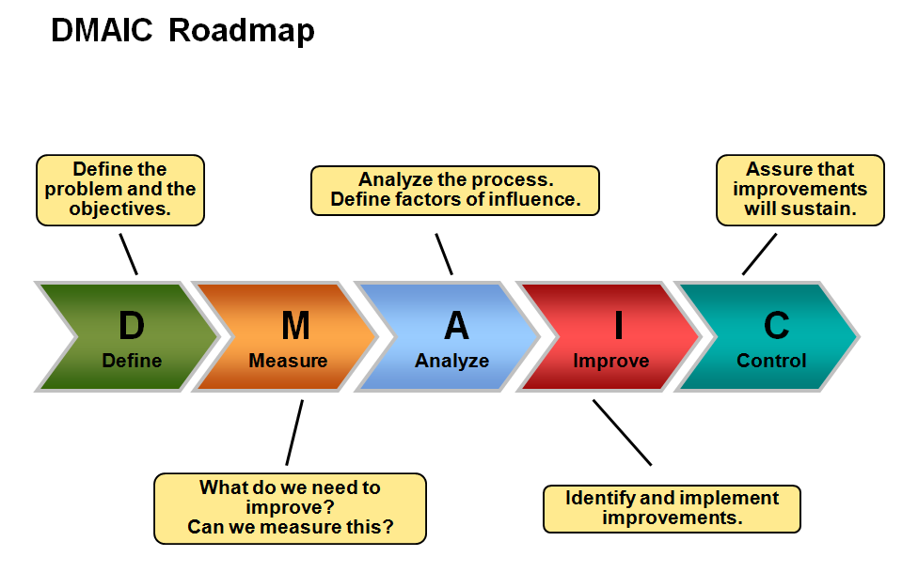

Slide 40
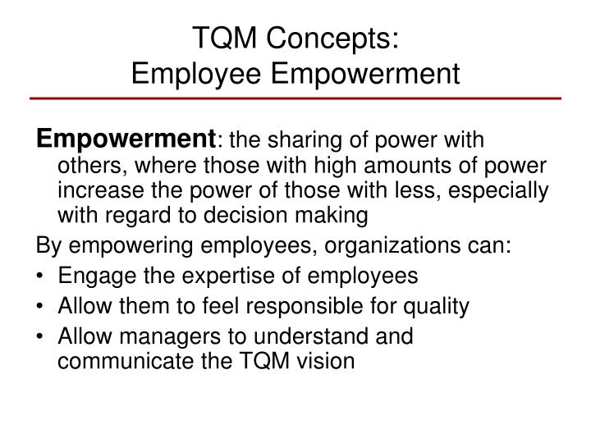
Employee Empowerment

Slide 41
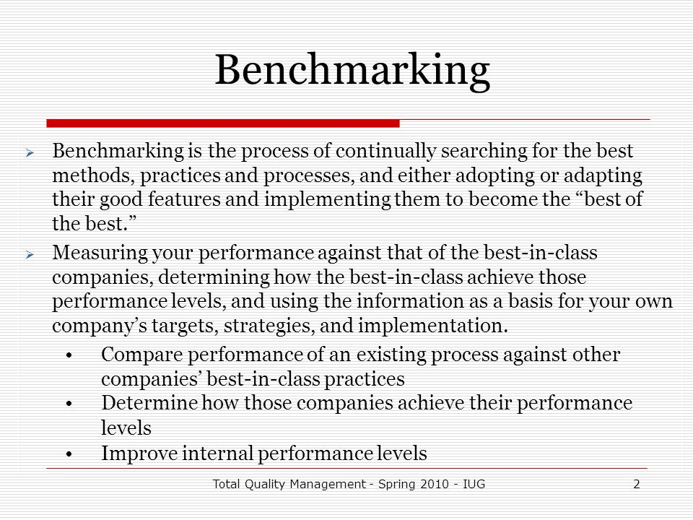
Benchmarking

Slide 42
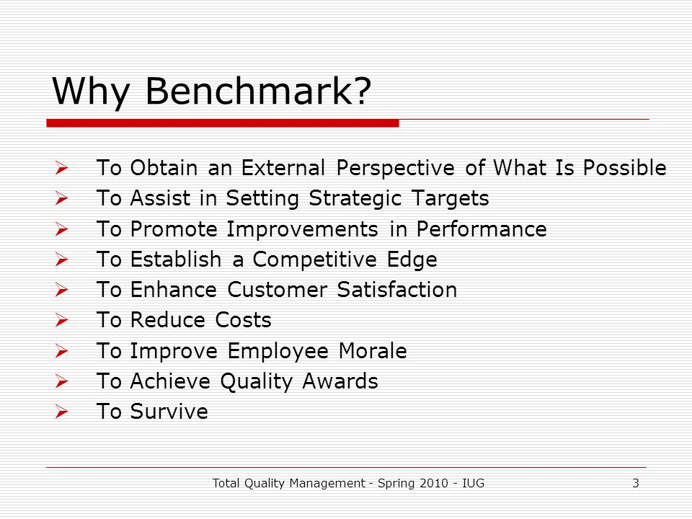
Why Benchmark?

Slide 43
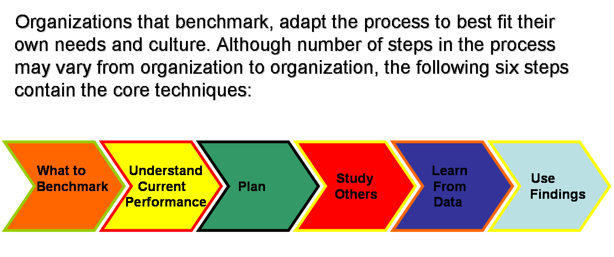
The Process of Benchmarking

Slide 44
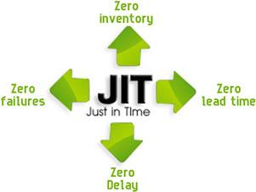
Just-In-Time
Notes:
https://www.youtube.com/watch?v=-2huDogfXS8

Slide 45
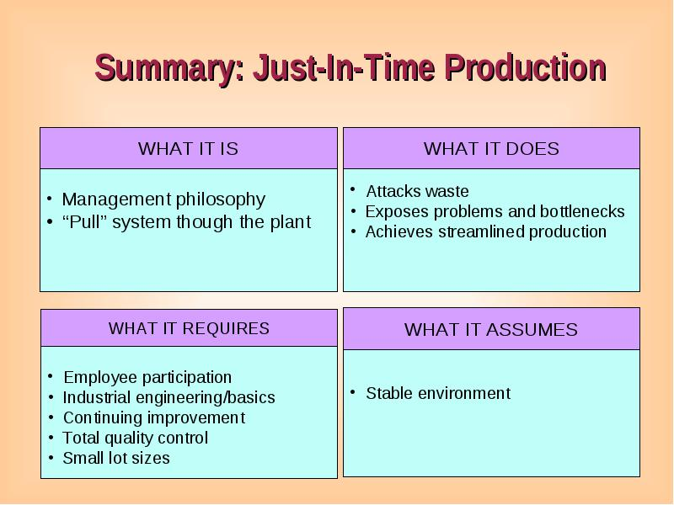

Slide 46
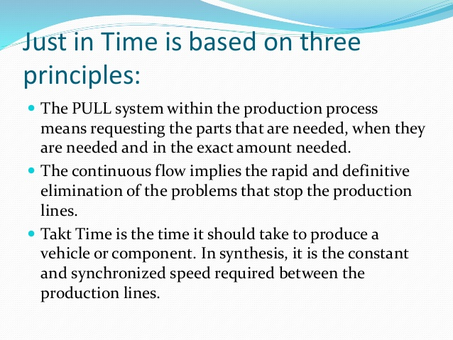
JIT is based on three principles:

Slide 47
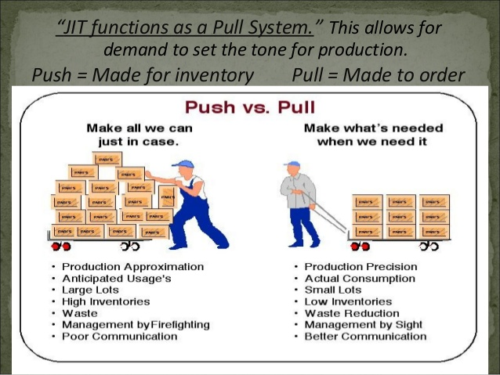

Slide 48
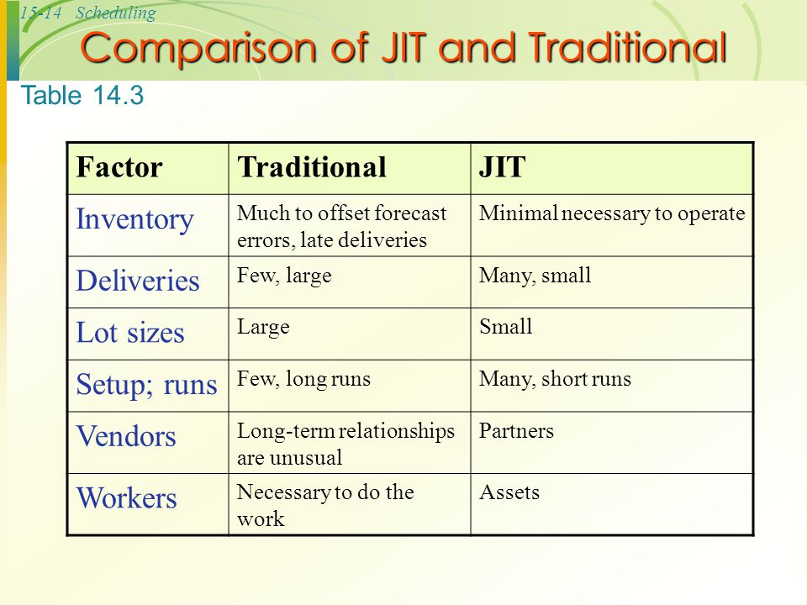

Slide 49
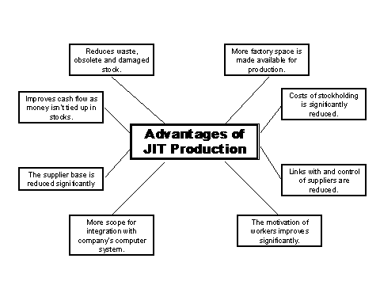

Slide 50
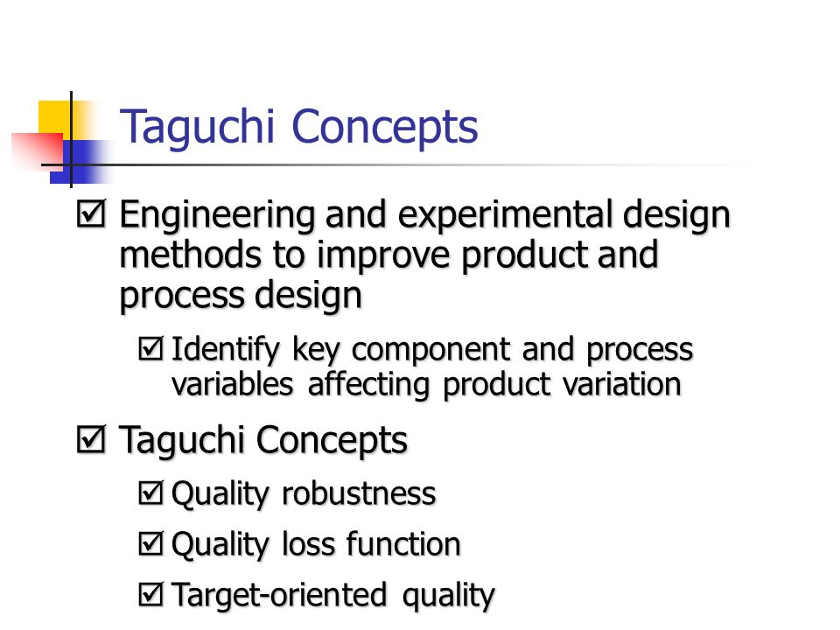
Taguchi Concept

Slide 51
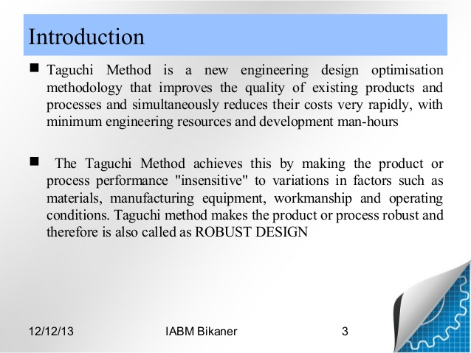

Slide 52
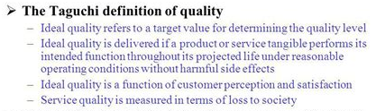

Slide 53



Taguchi Loss Function

Slide 54
Dr. Genichi Taguchi developed a practical approach for designing quality into products and processes. His methodology recognized that quality should not be defined as simply within or not within specifications, so he created a simple quadratic loss function to measure quality.

Slide 55

The two figures below contrast the typical 0-1 loss function used in quality with the Taguchi quadratic loss function.

Slide 56

Seven Tools of TQM

Slide 57


Slide 58

Ishikawa Cause and Effect (Fishbone) Diagram
Notes:
https://www.youtube.com/watch?v=I0c6Gd26Fxw
https://www.youtube.com/watch?v=rgBeC2j99LA

Slide 59


Slide 60

Lean Management Manufacturing/Production

Slide 61

Notes:
ttps://www.youtube.com/watch?v=wfsRAZUnonI
https://www.youtube.com/watch?v=d31RXl9mOO4

Slide 62


Slide 63


Slide 64


Slide 65


Slide 66


Slide 67


Slide 68


Slide 69


Slide 70


Commonalities of Both Methodologies

Slide 71


Slide 72


Slide 73


Slide 74


Slide 76


Slide 77


Slide 78


Slide 79


Slide 80


Slide 81


